Slide 1

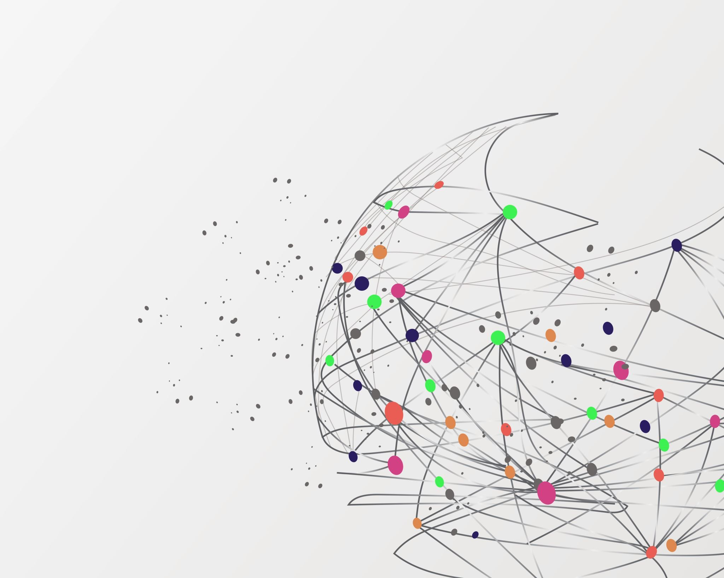
Azubi Africa Cloud Computing Project 2
Team Sublime Presentation

Slide 2

Team Members
Amos Mogaka Nyaburi
Brian Gitau
Christopher Yongo
Ebenezer Kuku
Emmanuel Bassey
Ifeanyi Okeibunor
Eva Naomi Njoroge
Nana Esi Ashun-Cobbina
Uwimana Alphonsine

Slide 3
PROJECT OVERVIEW
In project 1, we created a simple web page that allows visitors to register and submit their information via a User Interface(UI).
In this project we will create a dynamic webpage, demonstrating the use of Terraform to create AWS DynamoDB tables to dynamically populate a backend database with the users' log in information with the help of php-composer.
We begin this project by revamping the user interface of our webpage from V2 project. Thereafter, containerize our application in Docker.

Slide 4
TASK LIST
Create Amazon DynamoDB for storage using AWS Console.
1
Link DynamoDB to webpage using AWS SDK and php-composer.
2
Automate DynamoDB deployment using Terraform.
3
Package and deploy project version 3.
4

Slide 5
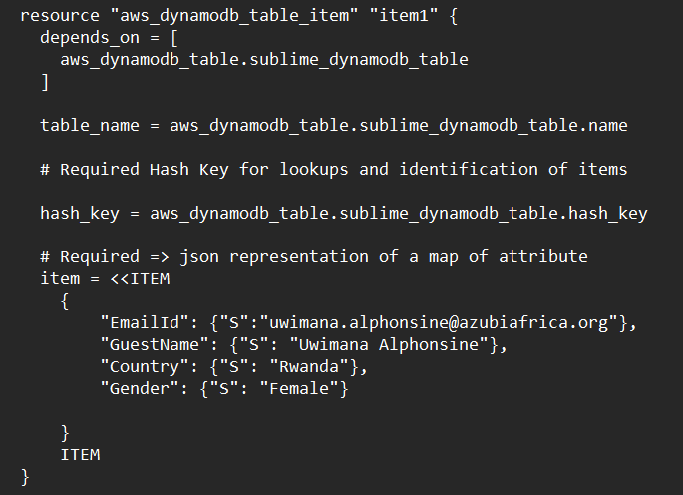
Create AWS DynamoDB for storage using AWS Console
This sample code inserts items to DynamoDB one at a time.
To insert a second item, add another table item using the same code changing “item1” to “item2” and the table item attributes.

Slide 6
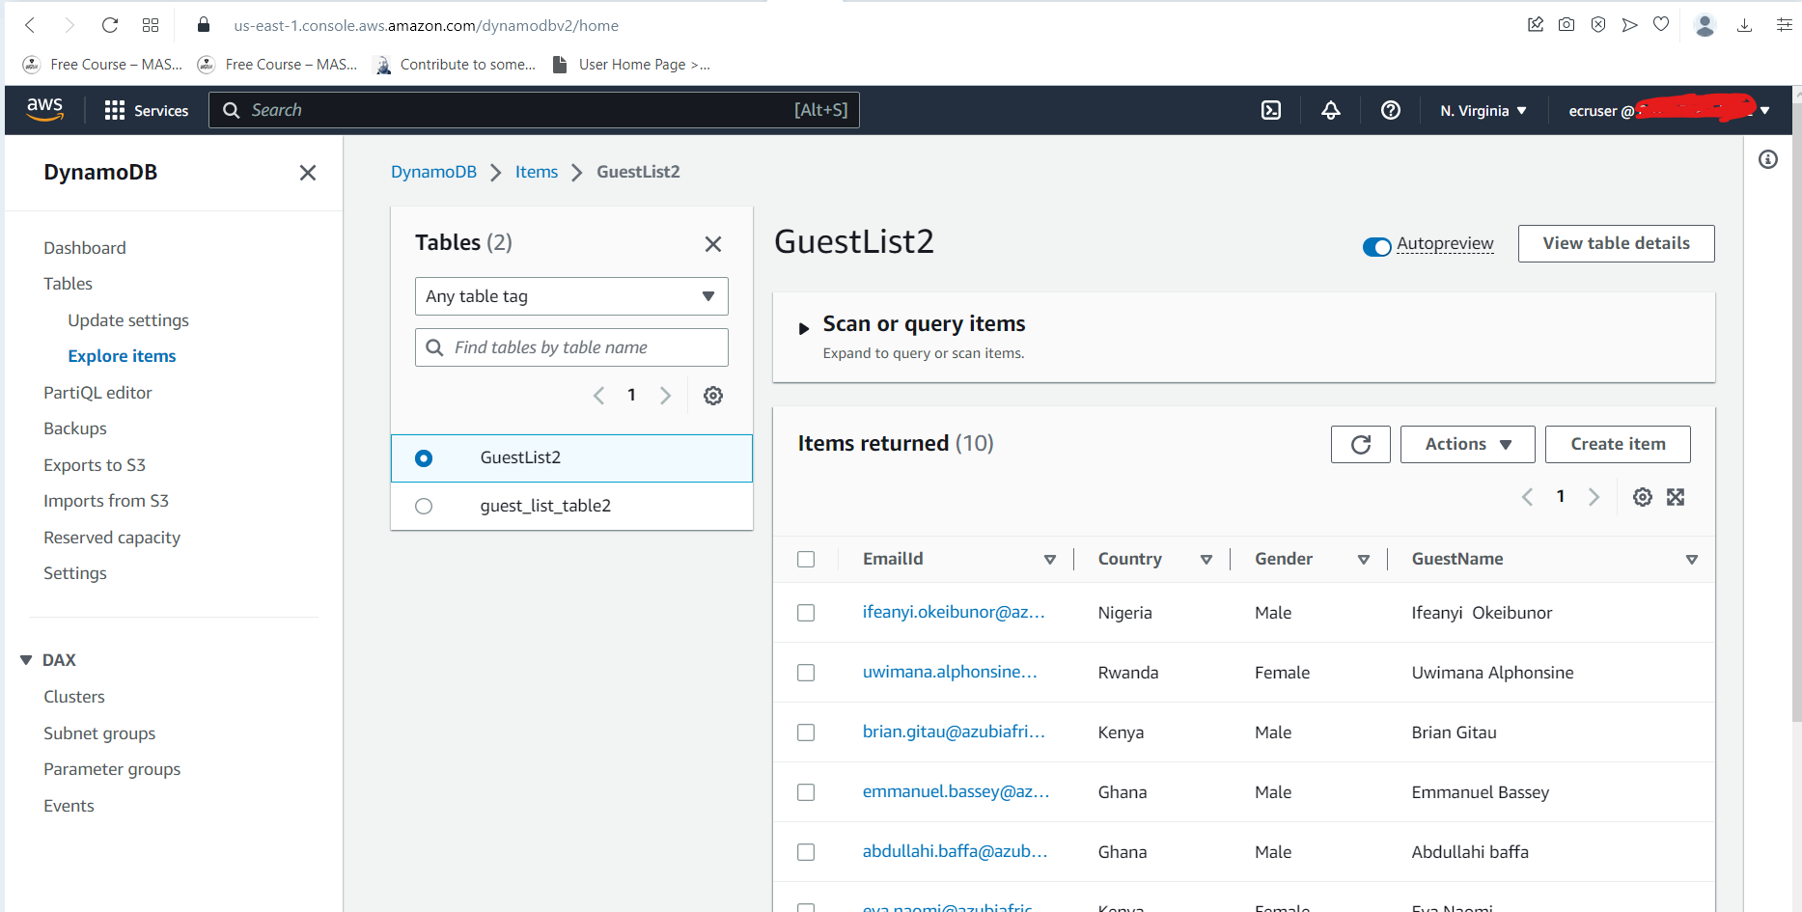
Photo of AWS DynamoDB

Slide 7
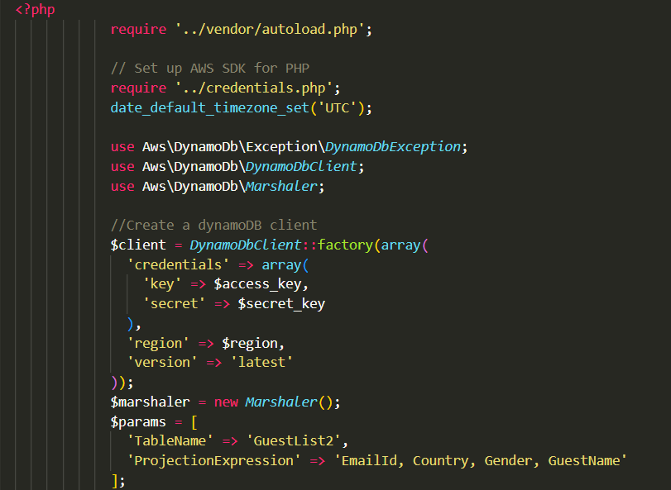
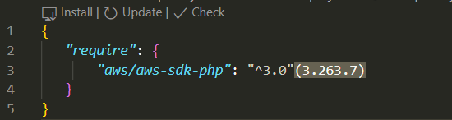
Link AWS DynamoDB to webpage using AWS SDK and php-composer
- Run composer require
vendor/aws/aws-sdk-php
- Vendor folder where composer downloads all the packages or project dependencies.

Slide 8
Automate AWS DynamoDB deployment using Terraform
Terraform is an open-source infrastructure as code software tool that provides a consistent CLI workflow to manage hundreds of cloud services (resources). Terraform codifies cloud APIs into declarative configuration files.
Basic Terraform Commands
{
terraform init – initialize the plugin as per the code
terraform fmt – neatly formats the terraform code
terraform plan – highlights on the code to be implemented and whether the configurations are correct
terraform apply – applies/runs the code to create our resources
terraform destroy - to kill and remove all the code and infrastructure build. Totally remove the programs built by terraform.
}
Configure Aws account to allow programmatic access and access to DynamoDb.
Obtain the secret keys and access ID. Store them in a separate file locally.

Slide 9
PHP-Composer
Is a dependency manager for PHP. It also has its own autoloader to enable autoloading.
1. Download composer https://getcomposer.org
Make composer globally or locally.
Require your first package.
2. Create a composer.json file that will declare to composer, the vendor's name you would like to install.
composer.lock will point to the version currently installed.
Composer Install
This looks for a Composer.lock file exists. If none exists, “composer update” will automatically run to create the composer.lock file. If composer.lock file exists, then install the declared dependencies from here (working directory).
1. Download composer https://getcomposer.org
Make composer globally or locally.
Require your first package.

Slide 10
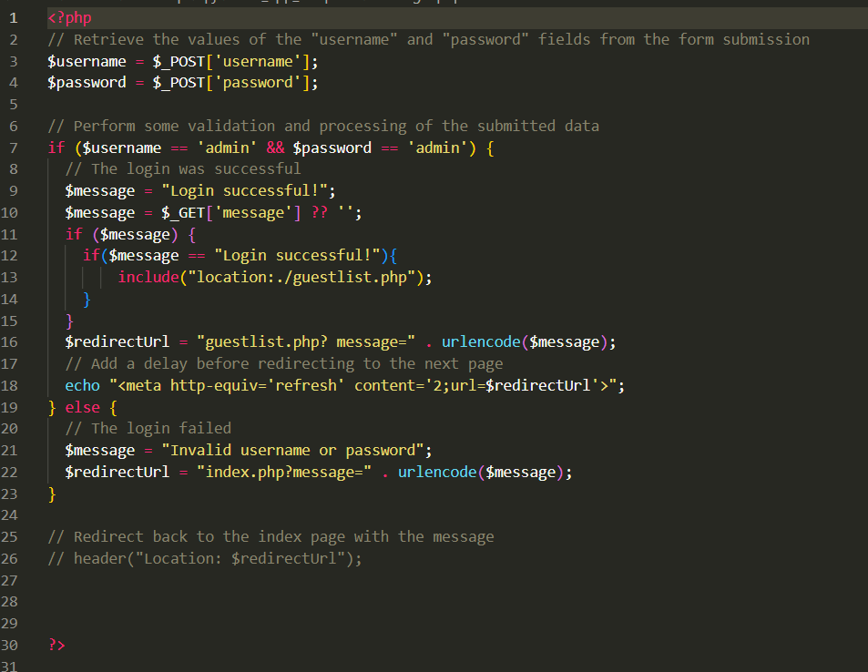
PHP Login code

Slide 11
Package and deploy project version 3 (Dockerization of the application)
4 simple steps to push image to docker hub:
docker login --username username
prompts for password. If you omit --password which is recommended as it does not store it in your command history.
docker tag my-image username/my-repo.
docker tag docker-web-app:3.0 username/docker-web-app:3.0
docker push username/my-repo.
docker push username/docker-web-app:3.0

Slide 12
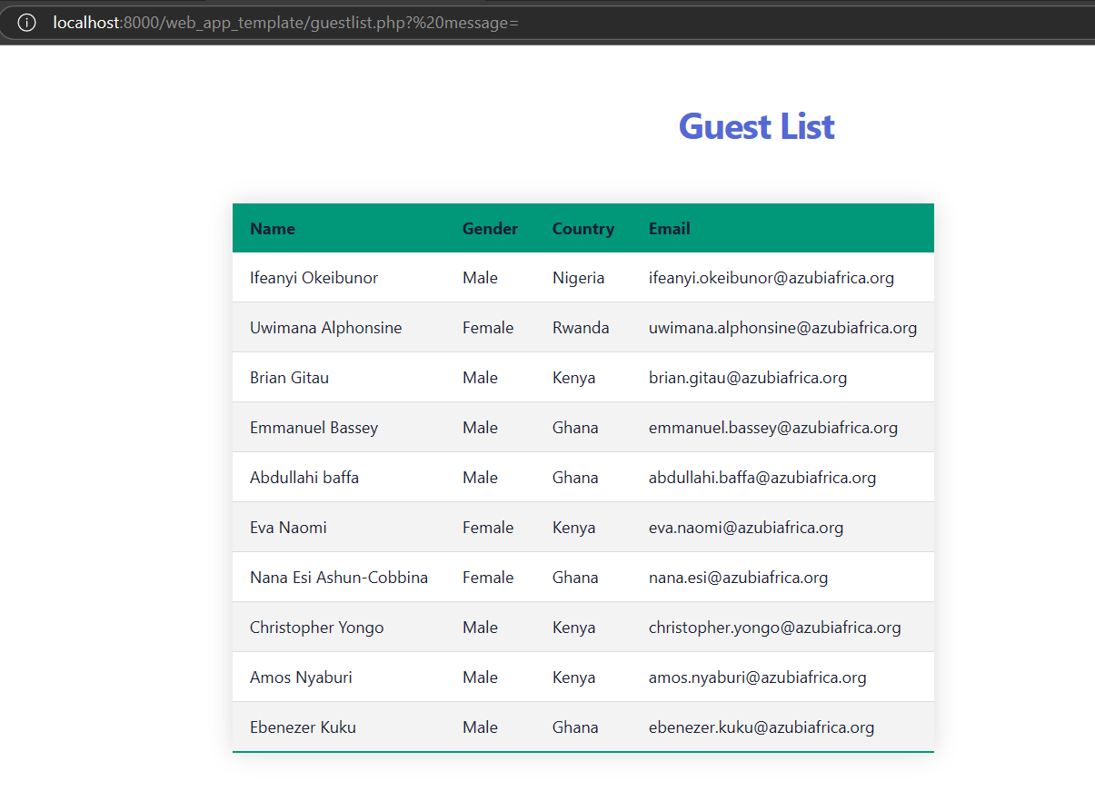
Photo of guest list in Docker

Slide 13
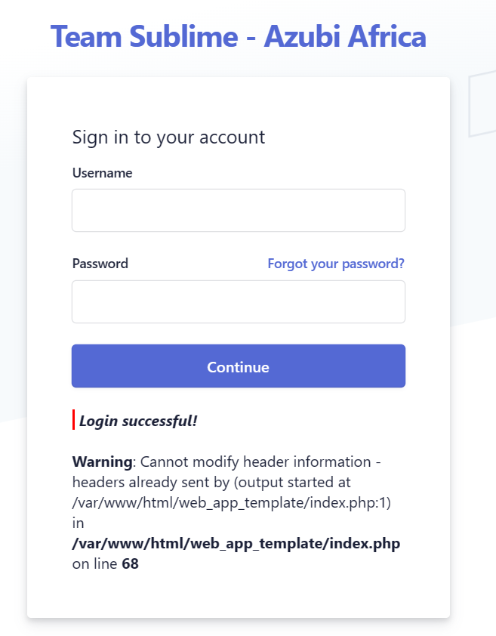
Challenge 1
The code was working but instead of redirecting to guestlist.php, it was redirecting to index.php.
After several attempts, it was noticed that there was just a small error in the login.php code so it was rewritten.
The image on the right indicates the error message.

Slide 14
Challenge 2
Terraform failure due to semantic and syntax error.
We resolved this after several hours of concerted effort from teammates by troubleshooting.

Slide 15
The End.

